Slide 1
National Vascular Registry
IT System and Online Reporting

Slide 2
NVR IT System
Built by Northgate Public Services
Went live in December 2013
Replaced old National Vascular Database (run jointly between Vascular Society and RCP)
Housed on secure N3 server:
Pros: more secure, nightly linkage to National AAA Screening Programme
Cons: Speed can be an issue, can’t access it from outside NHS computer or VPN

Slide 3
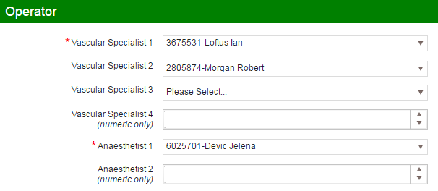
Users
Each user type has different roles and rights in the IT system, which affects data entry, searching and reporting:
Consultants
Surgeons
Radiologists
Anaesthetists
Local admins
Global admin (me!)

Slide 4
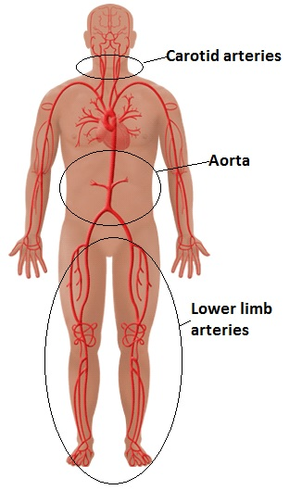
Procedures
Approx. 196,000 records on the NVR
51,000 carotid endarterectomies
66,000 repairs of abdominal aortic aneurysms
12,000 lower limb angioplasties/stents
41,000 lower limb bypasses
26,000 lower limb amputations

Slide 5
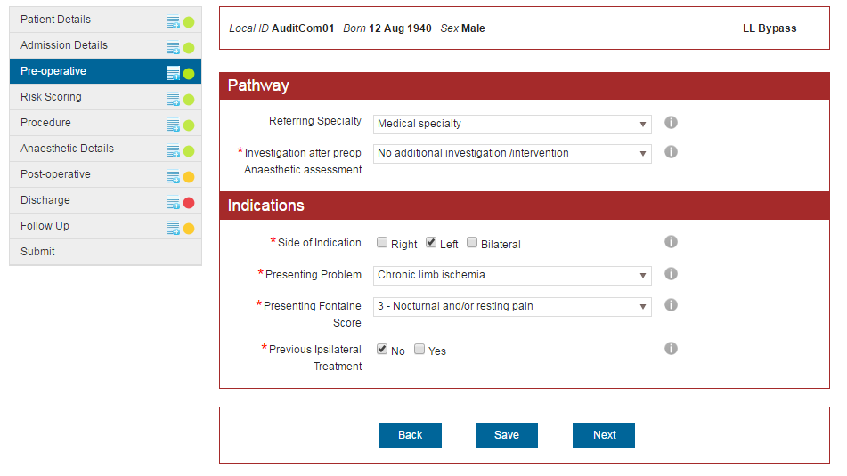
Entering Data
Notes:
Side bar – allows the user to quickly see which pages have been completed – RAG traffic lights
Top bar – allows user to quickly see which patient they are working on. Local ID, DOB, Gender, (NHS/CHI Number), Procedure Type
Colour of banner based on procedure type. Carotid – yellow/orange, AAA – green, Angio – blue, Bypass – Red/Maroon, Amputation – purple
I button – contains help text for the question.

Slide 6
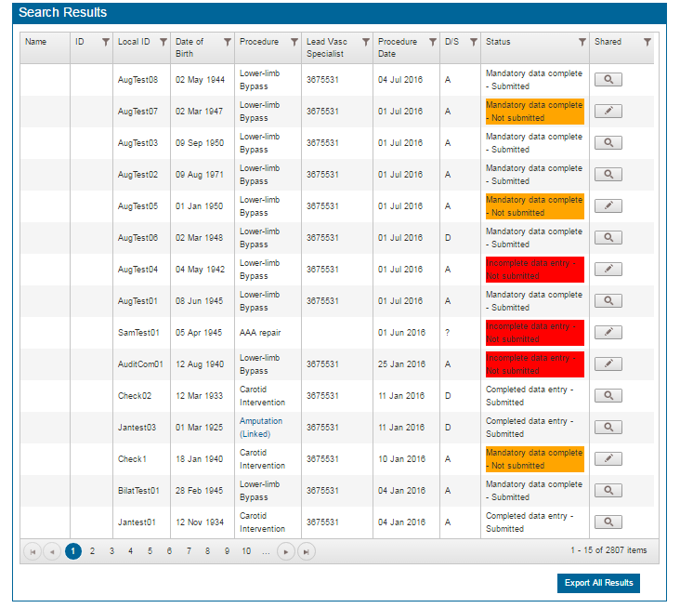
Episode Search Screen
Notes:
Header row. Allows user to sort by any of the columns, either ascending or descending. Also able to filter by any of them too.
Colours to show whether records has been submitted
Export button to look at data in Excel

Slide 7
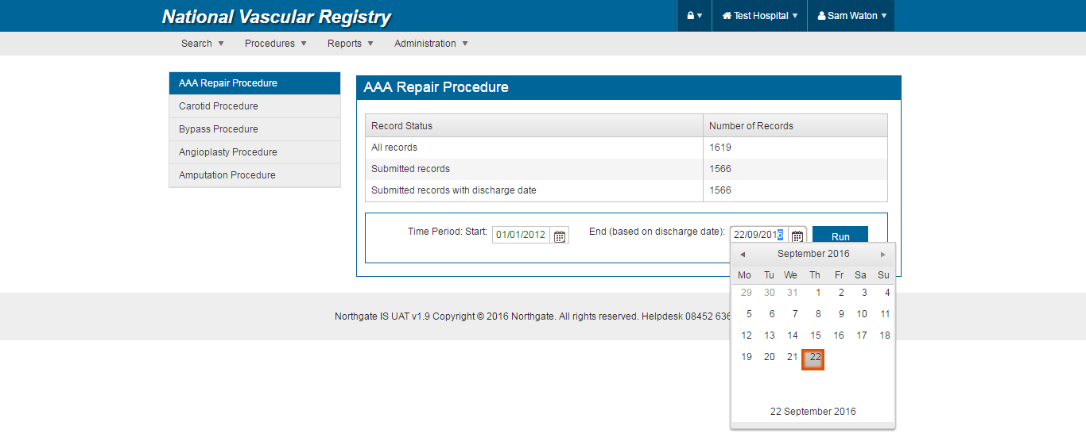
Online Reporting Tables - 1
Available for each procedure on the NVR.
Only calculated using submitted records (and legacy records with discharge information complete).
Start and end dates can be changed by the user.

Slide 8
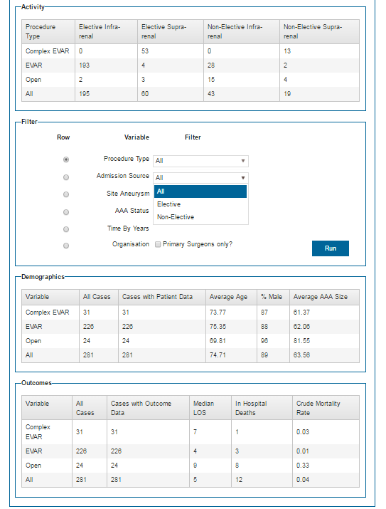
Online Reporting Tables - 2
Basic AAA activity numbers are shown at the top.
The user is able to filter any of the variable options if they require.
They can also set any of the variables to be the primary method of breaking down the results
E.g. the procedure type has been chosen as the ‘Row’ in this example.
Demographics and outcomes shown at the bottom.

Slide 9
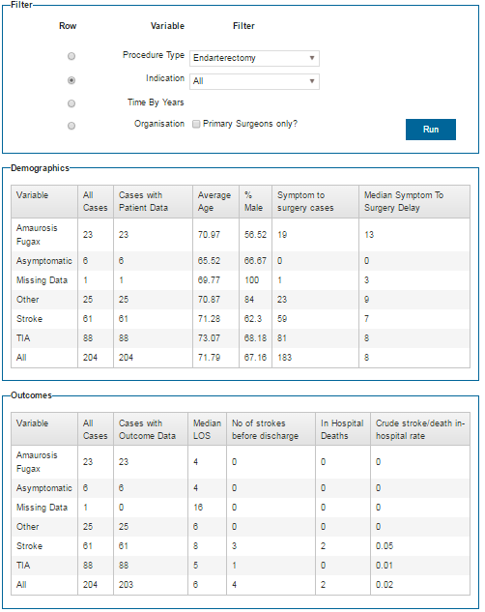
Online Reporting Tables - 3
Example of an online reporting table for carotid endarterectomy.
Different filtering options, demographics and outcomes for each NVR procedure.

Slide 10
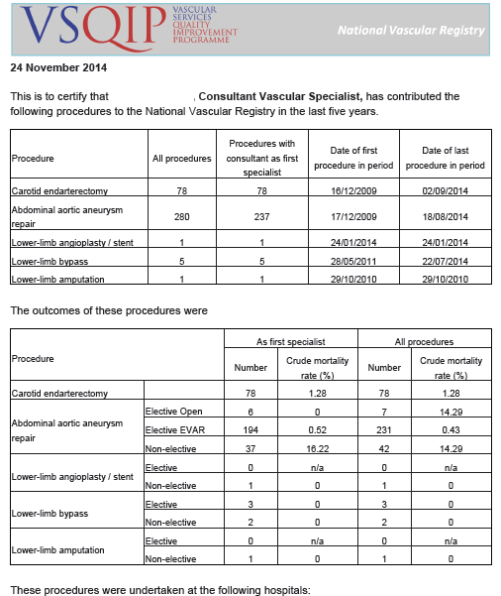
Revalidation Report
Available for consultants to see and download as a pdf.
Cannot be edited.
Designed to easily added to a consultant’s portfolio.

Slide 11
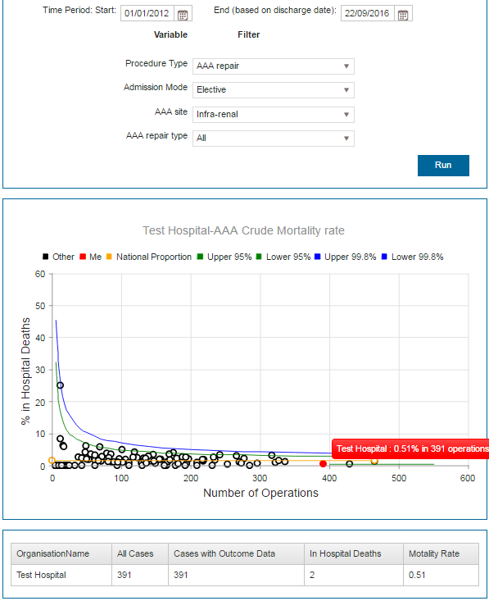
Funnel Plots
Dates and a few options can be edited by users.
Funnel plot is not risk adjusted.
If logged on as a consultant the ‘dots’ are consultants.
If logged on as a hospital admin the ‘dots’ are hospitals.
‘You’ are shown in red.
Ability to show and hide features within plot.

Slide 12
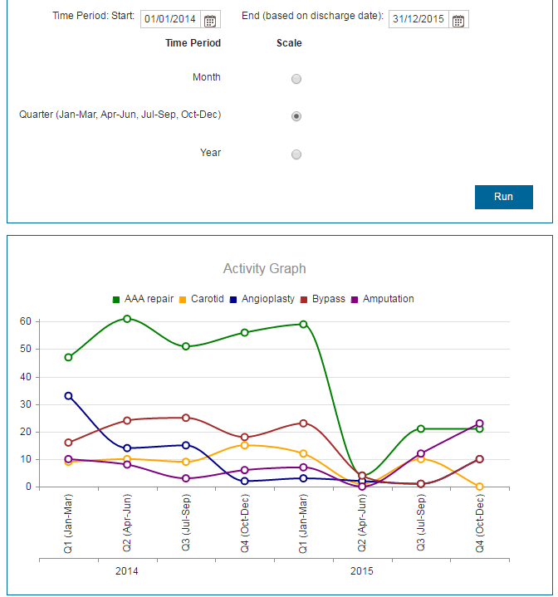
Activity Graphs
A user can select the start and finish dates.
The time period can be month, quarter or year.
Basic time series graphs.
Procedure types can be hidden/shown if required.

Slide 13
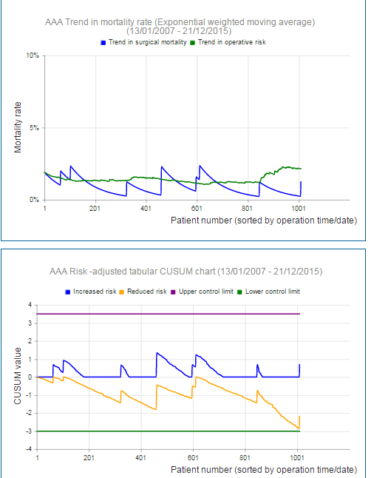
Continuous Monitoring Plots - 1
Top graph based on risk adjusted EWMA
Blue line is average mortality rate, based on EWMA of the previous sequence.
Will spike up if patient dies, will fall if patient is discharged alive.
Green line shows average predicted risk, based on patient characteristics.
Will rise if cohort of patients becomes more high-risk and fall if they become less high-risk.
Lower graph is a risk adjusted double-sided CUSUM chart.
Suggests outlier due to poor performance if blue line crosses purple limit, and good performance if yellow line crosses green limit.
Notes:
The CUSUM chart uses a probability testing procedure that sequentially assesses whether the observed adverse outcome rate is consistent with the expected baseline rate.
In statistical terms, the plotted value in the upper part of the CUSUM chart is the log likelihood of detecting a doubling in the odds of an adverse outcome.
The value plotted in the lower part of the CUSUM chart is the log likelihood of detecting a halving in the odds of an adverse outcome.

Slide 14
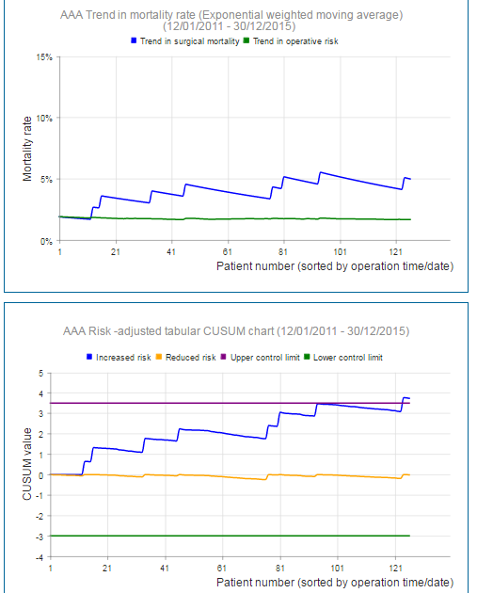
Continuous Monitoring Plots - 2
Good for looking at results entered in realtime.
Hopefully can pickup any issues before NVR analysis is carried out.
However, can be difficult to understand.
Not as effective if cases are entered in batches just before data submission deadline.
How do they fit into outlier policy?
Limits are designed to be more strict that funnel plots.
Not feasible for NVR team to monitor results on behalf of trusts/surgeons.

Slide 15
Online Reports – Are they used?
Short answer – not entirely sure!
Users (surgeons) not afraid to complain about issues!
However are less forthcoming when they are asked how things could be improved
We regularly point users with queries to them.
Never going to be as accurate as ‘offline’ analysis:
Data cleaning
Duplicates
Incomplete legacy data
Procedural OPCS coding issues

Slide 16
Some personal thoughts/recommendations
When designing registries and working with IT providers:
Be very specific on the specs of the database, including all validation rules. Changes can be time consuming and costly!
Involve a statistician/methodologist at an early stage.
Useful for project manager to act as ‘middle man’ between clinicians and IT provider/developer.
Do you want records to be submitted prior to analysis?
If so provide a facility to unlock submitted records.
If a question is not mandatory, should it be asked?
Ability for admins to ‘force submit records.’
Think about how data will be analysed and presented?
Pdf annual reports, website based results, COP, NHS Choices

